Slide 1
Medical Question Answering
Akshay Shah (21011101016)
Karthik Palaniappan (21011101051)

Slide 2
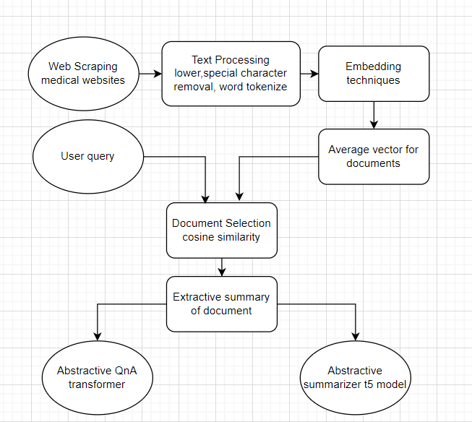
Pipeline

Slide 3
Embedding Techniques
Sentence Transformer:
Built on the Bert model, it provides a pooled vector representing the entire sentence, offering accurate semantic meaning and effective performance in extractive summarization.
Word2Vec:
Word2Vec captures relationships between neighboring words but lacks in grasping global word meanings. It’s also utilized in extractive summarization tasks.
Glove:
Glove furnishes a global representation for each word, aiding in preserving semantic relationships between words. It's employed in document retrieval.
TF – IDF / Bag of words :
TF-IDF indicates a word's importance in a document relative to a document collection. It's widely applied in information retrieval tasks, like document search engines, aligning with our task effectively

Slide 4
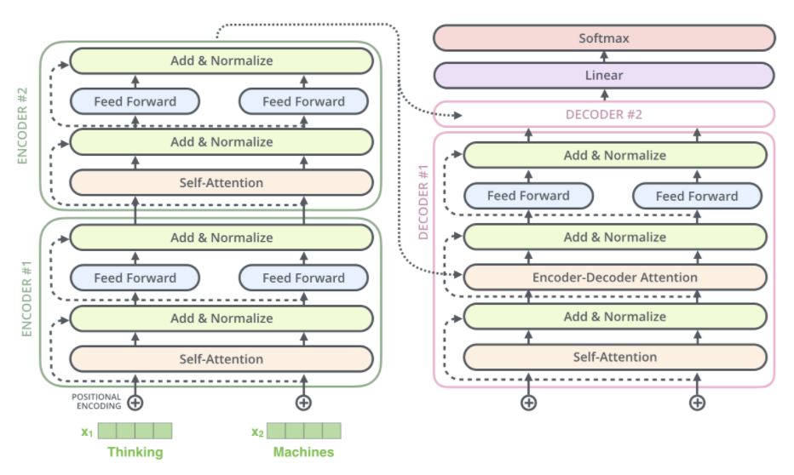
Models
T5:
It is a Transformer based architecture that uses a text-to-text approach. Every task – including translation, question answering, and classification – is cast as feeding the model text as input and training it to generate some target text.
In our task, once the previous model finds the relevant document, the query and the document’s extractive summary is passed as context to the t5 model which generates the final answer.

Slide 5
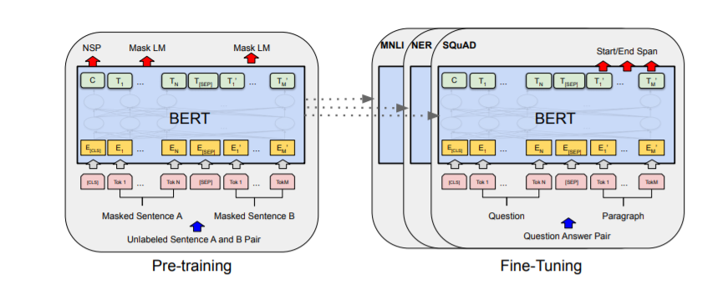
Models
Roberta QNA :
It is fine-tuned using the SQuAD2.0 dataset, it's been trained on question-answer pairs, including unanswerable questions, for the task of Question Answering.
This model is also used to generate output from extractive summary

Slide 6
Models
Falcons.AI Model for medical summarization :
The T5 Large model for Medical Text Summarization is a specialized variant of the T5 transformer model, fine-tuned for the task of summarizing medical text. This model is designed to generate concise and coherent summaries of medical documents, research papers, clinical notes, and other healthcare-related text.
The performance of this abstractive summarization is far better compared to other QnA generative models.

Slide 7
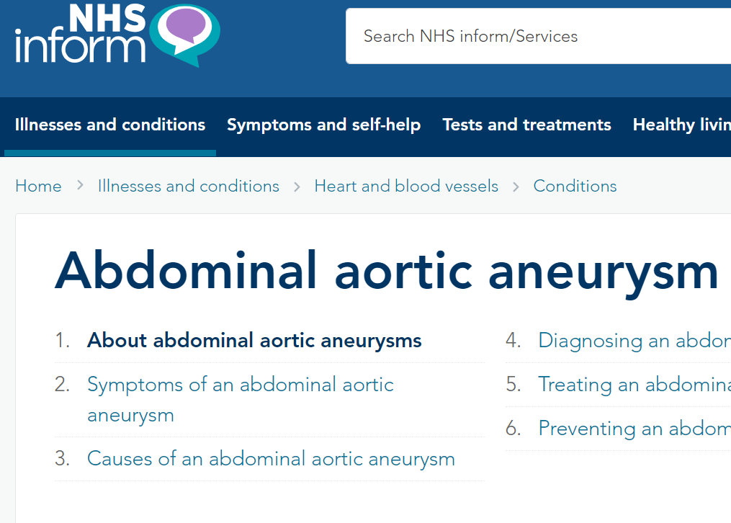
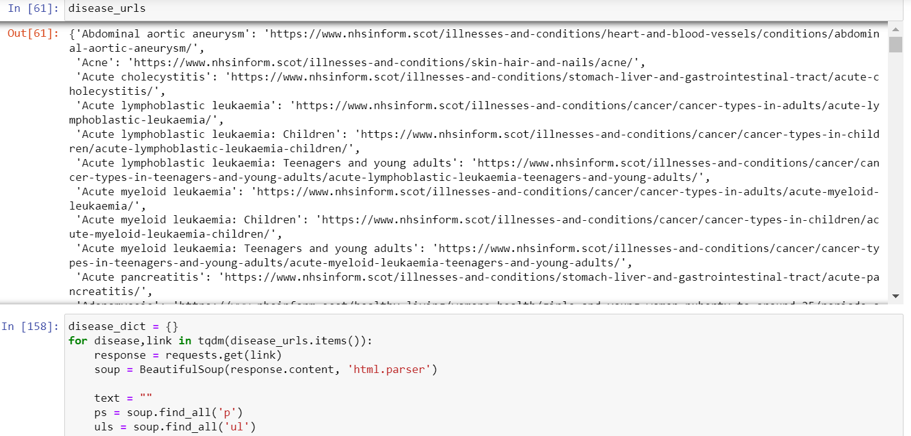
Results
Web Scrapping:
After not being able to find a dataset that accurately represented all kinds of diseases and their information, we decided to scrape the data through the NHS website.

Slide 8
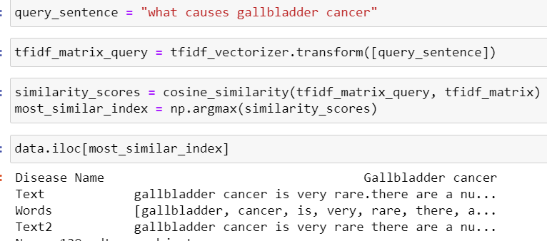
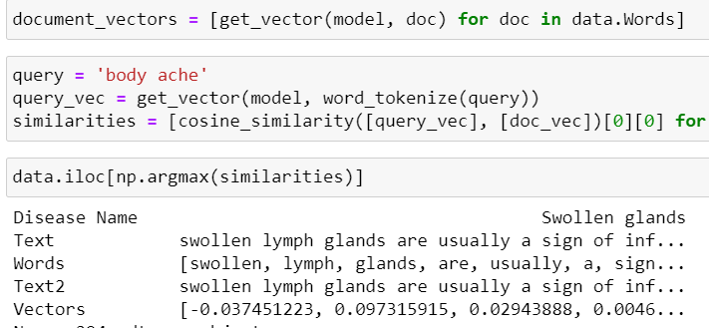
Results
Document retrieval:
TF – IDF performs the best in document retrieval because it matches all the keywords and provides a syntactic way of finding the relevant document.
TF – IDF
Word2Vec

Slide 9
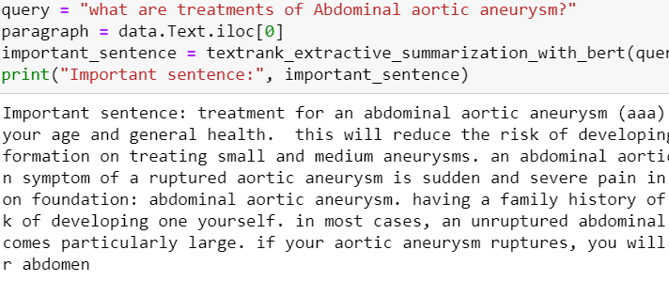
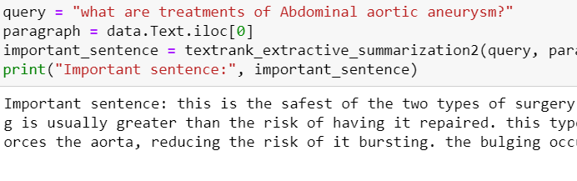
Results
Extractive summary:
Sentence transformer works better than glove in Extractive summary because in glove, the sentence vector is taken as the average of word vectors whereas sentence transformer is designed to directly give sentence vector with more semantic understanding.
Sentence transformer
Glove

Slide 10
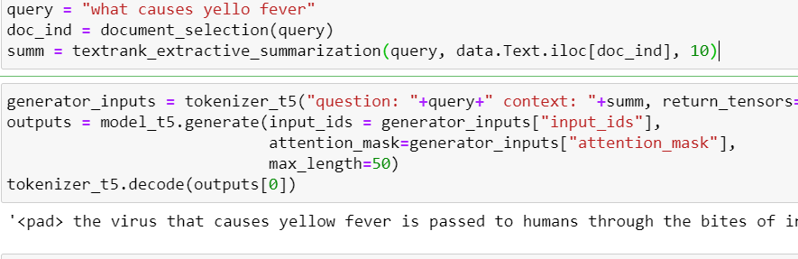
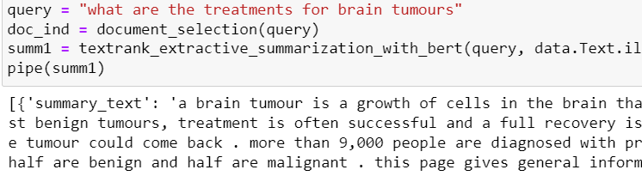
Results
Abstractive output:
Medical summarizer performs better than the Q&A models(t5, Roberta q&a) because it is trained on medical documents and the extractive summary already contains the answer so there is no need to generate a new answer using it as a context.
T5 Q&A
Glove

Slide 11
THANK YOU

